Slide 1
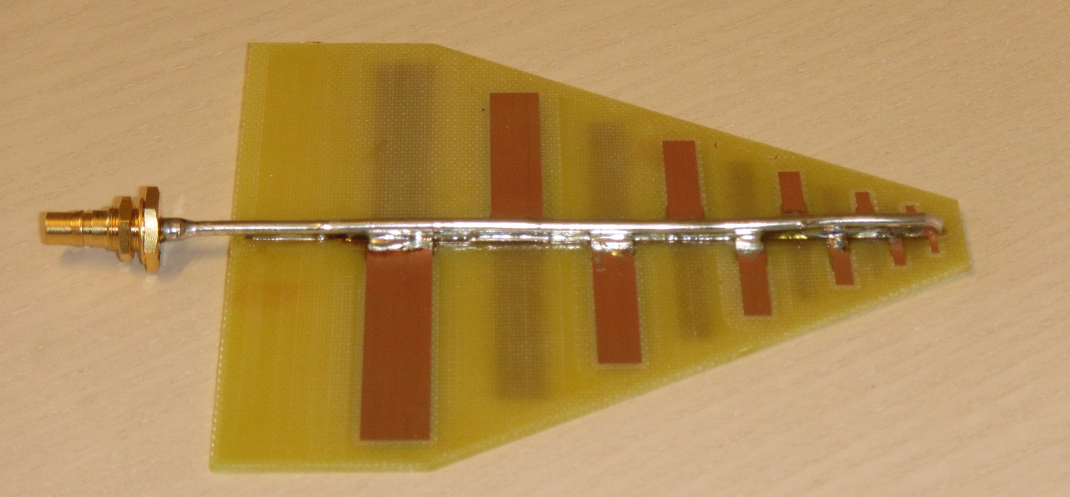
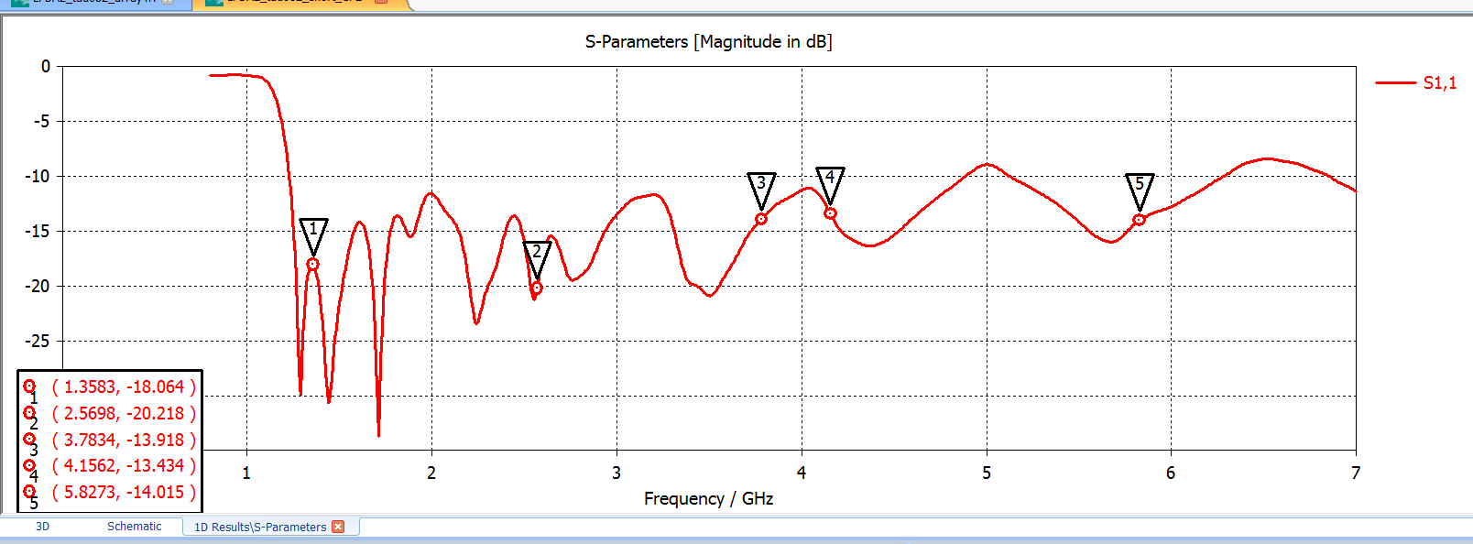
Log Periodic Dipole Array
Frequency range: 1.3 – 6 GHz
Return loss: < 10 dB
Gain: 6 – 7 dBi
Connector: QMA (50 Ohm)
E-plane beamwidth: 70-80 deg
H-plane beamwidth: 110-150 deg

Slide 2
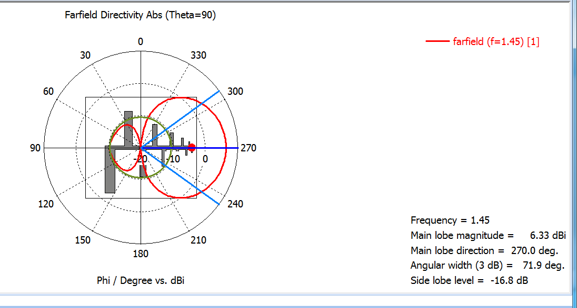
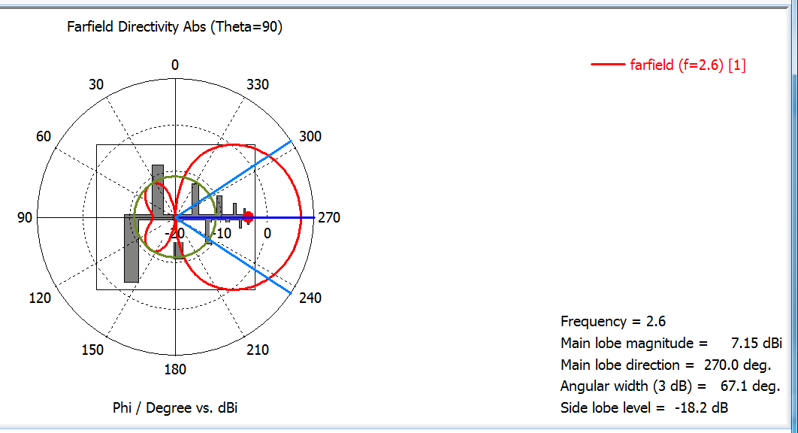

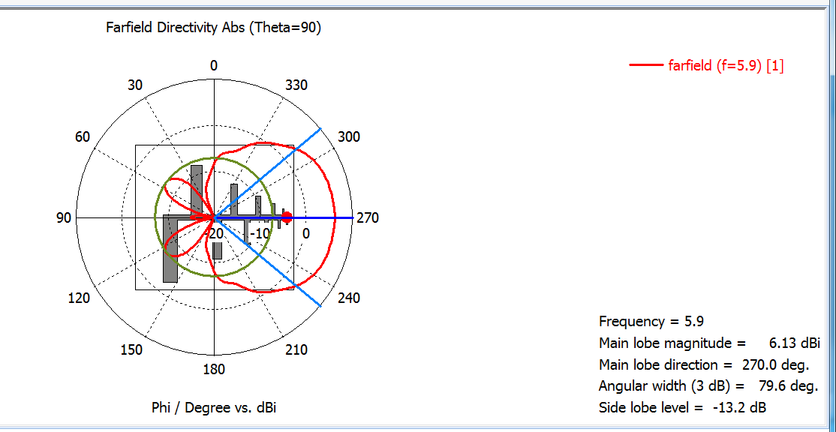
E-plane radiation patterns

Slide 3
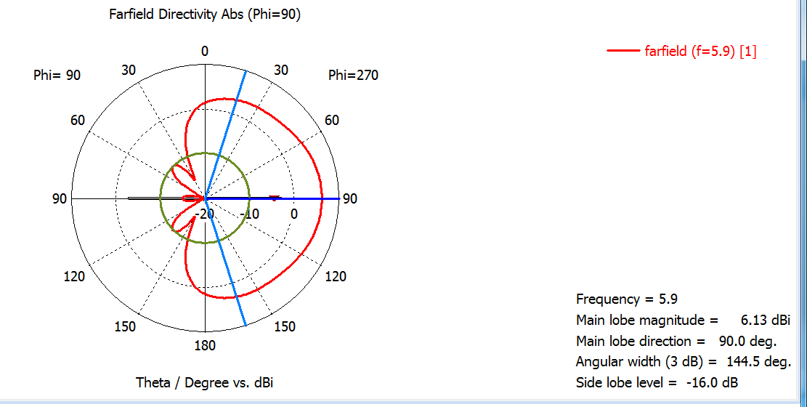

Slide 4
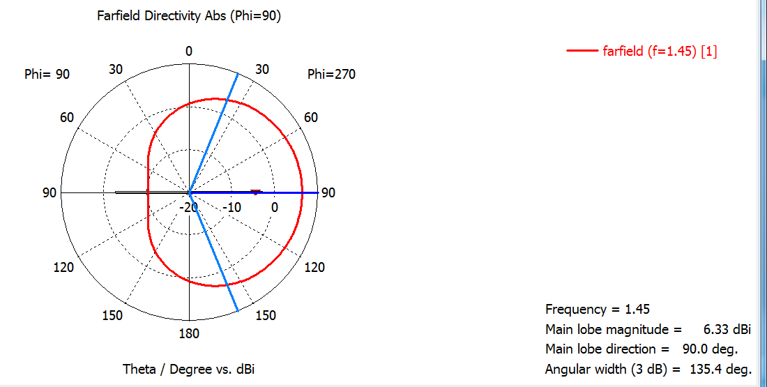

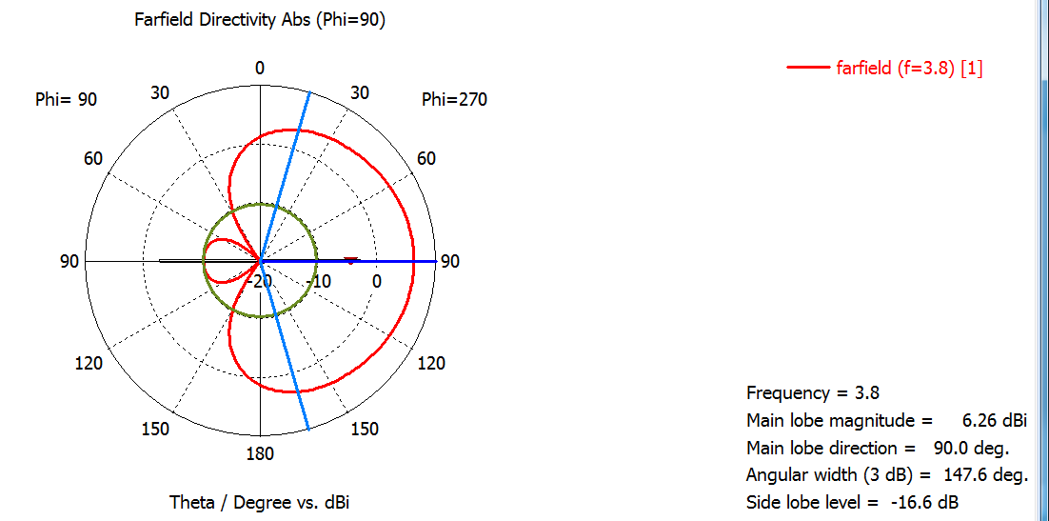
H-plane radiation patterns

